Slide 1
Internship Tasks Overview
-Sathyajith Shanthkumar (15/10/2024-15/04/2025)

Slide 2
Contents
2. Tasks using python
Data filtering, visualization and automation
2. Clean room Tasks
Resist stripping
Quality management of Bonding misalignment
Surface scanning
Contact angle measurement
Ellipsometry
Microscopy
3. Git version control and update
1. Introduction
4. Conclusion and Key takeaways

Slide 3
00
Introduction

Slide 4

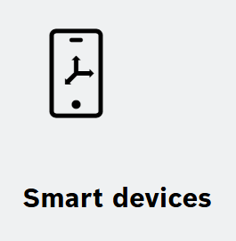
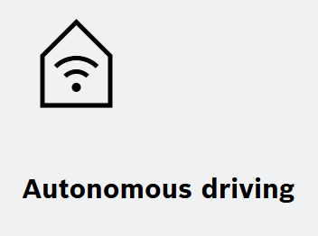
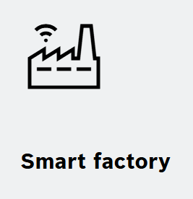

Overview
Introduction
Bosch is a global market leader in MEMS sensors, with over 10 billion sensors produced to date [1].
Revolutionary technology from Bosch: With the invention of the “Bosch Process,” the company’s researchers shaped modern sensor engineering [1].
Internship Department: Engineering Sensor Technology Center.
Department Focus:
Manufacturing processes of next-generation, state-of-the-art sensors
Development and enhancement of sensors currently in use
Internship duration: 6 Months (15/10/2024-15/04/2025)
Figure 1: Few sensors manufactured at bosch [1]
AREAS OF SENSOR APPLICATION [1]

Slide 5
01
Python:
data filtering, automation and visualization

Slide 6
Data filtering and Automation
Python Script Development:
End-to-End Automation: Automating data extraction, aggregation, and organization across multiple files using libraries like pandas and NumPy, saving time and effort.
Data Filtering & Aggregation: Automatically filters and calculates key metrics like averages, standard deviations, and other essential statistics.
Efficient Data Organization: Organizes the extracted data into structured collections, for more efficient access and analysis.
Automated Output and documentation: Results are automatically saved into a well-structured Excel file, with each dataset clearly labeled for easy reference and future use.

Slide 7
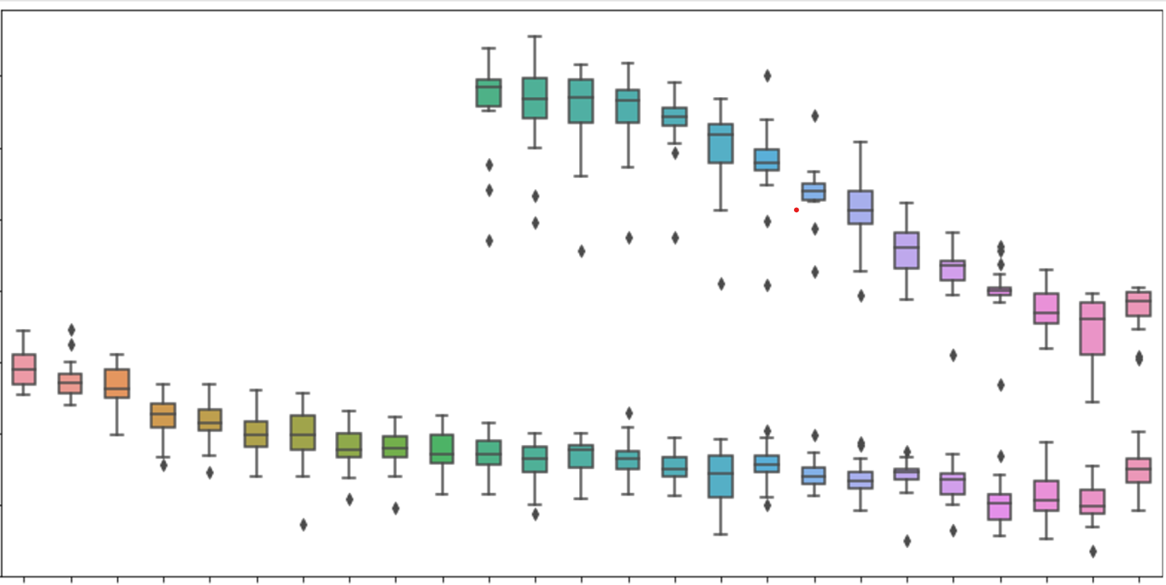
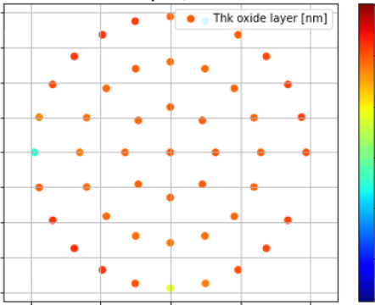
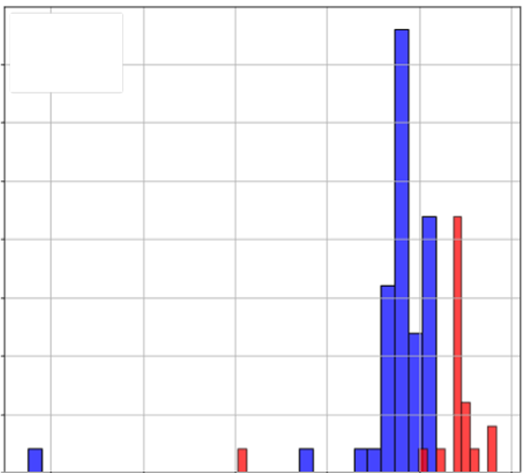
Data Visualization
Python Script Development:
Some of the different types of data visualistion done using python is shown above. The type of plot is based on the task specification. All the graphs/charts are done using matplotlib or seaborn modules
Boxplot
Scatterplot
Histogram

Slide 8
02
Quality management for a bonding step using python

Slide 9
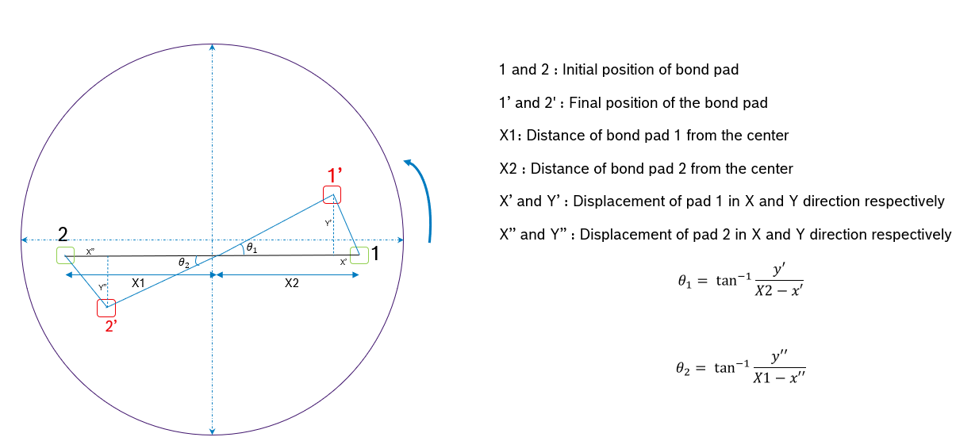
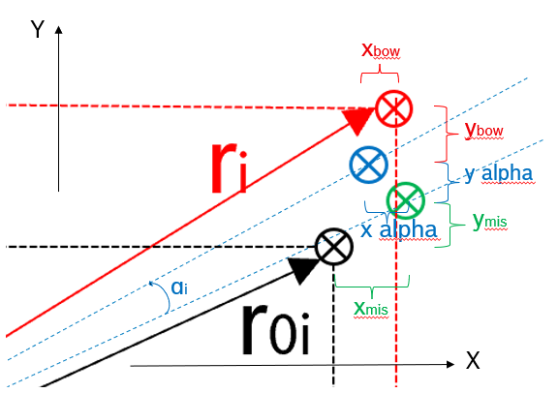
Description
Quality assurance for a bonding using python
Bond alignment measurement is a quality control implemented after bonding
Bond alignment is measured with IR immediately after bonding procedure
2 sets of files were used for calculation: 1. Two point 2. Full map
Two point:
Full map:
Where:
xmis, displacement of the wafer on x-axis
ymis, displacement of the wafer on y-axis
xα,i = rotation of the wafer at point i projected on x-axis
yα,i = rotation of the wafer at point i projected on y-axis
xbow,i = fct(ri) , deformation of the wafer projected on x-axis
Ybow,i = fct(ri) , deformation of the wafer projected on y-axis
Δx,i = xmis + xα,i + xbow,i
Δy,i = ymis + yα,i + ybow,i

Slide 10
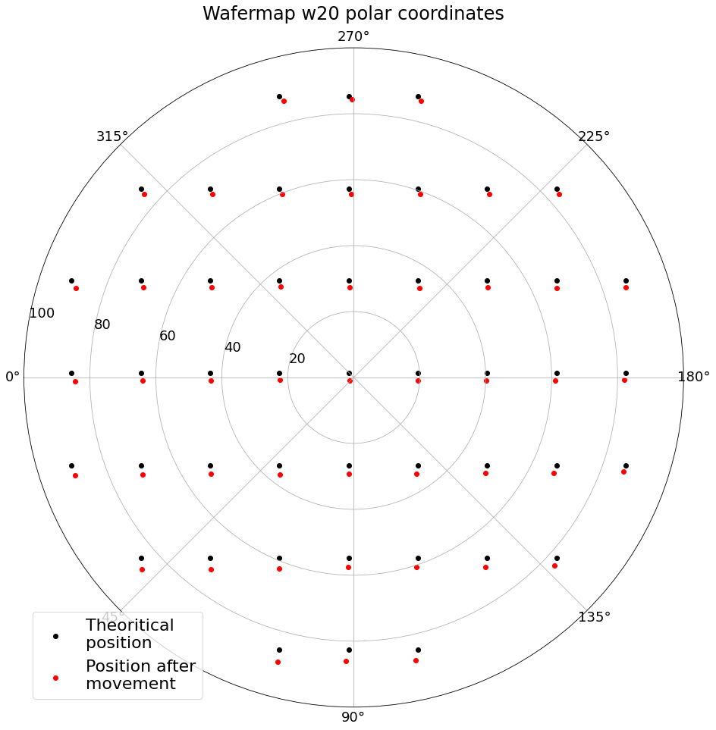
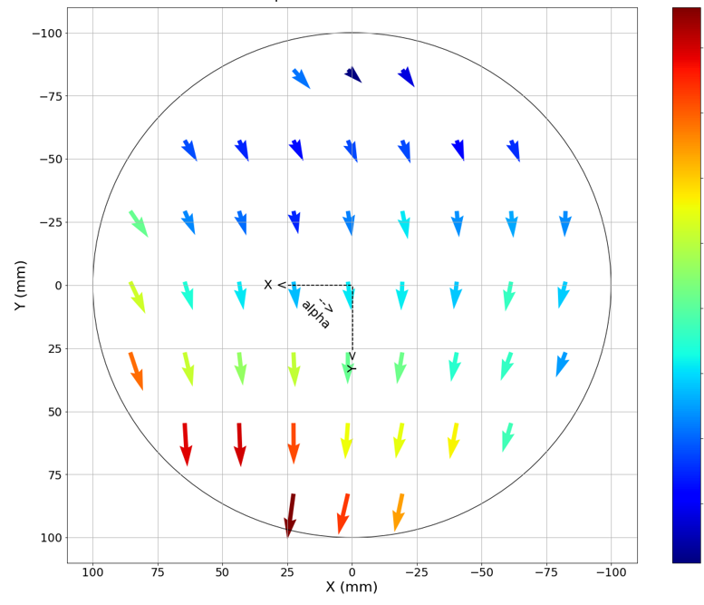
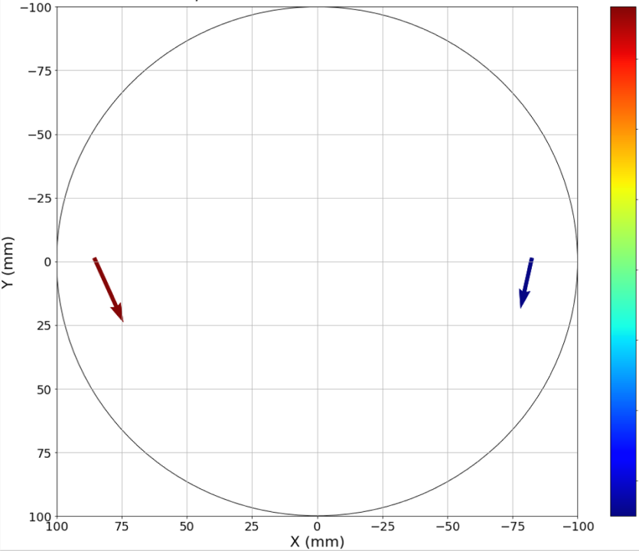
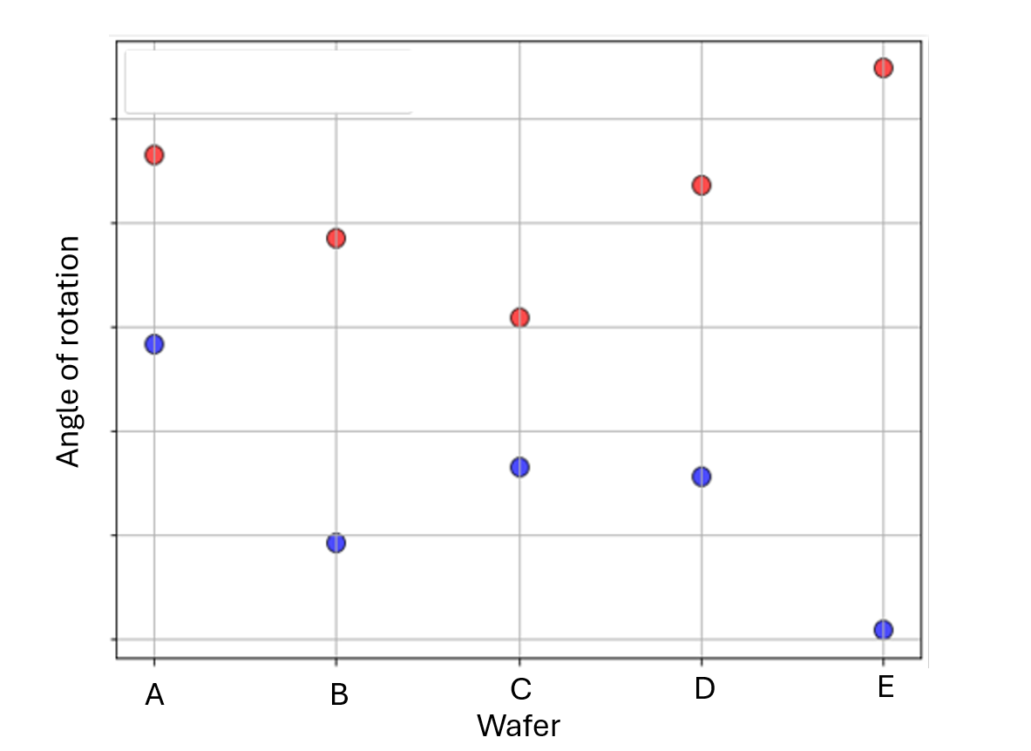
Results
Quality assurance for a bonding using python
1
2
Image 1: Indicates the initial and final position after bond pads
Image 2: Indicates the direction of displacement
Image 3: Indicates the direction of displacement in two points
Image 4: Indicates the rotation of different wafer under observation
Python modules used: Numpy, pandas, matplotlib, seaborn
3
4

Slide 11
Process Flow and the respective modules used
Quality assurance for a bonding using python
Introduction
Data Importation
Misalignment Calculation
Data Organization
Visualization
Matrix System Method Curve Fit Method and Comparison
Saving Results
Conclusion
Pandas
Used for data manipulation and analysis. It is used to create and manage data frames.
Numpy
Used for numerical computations. It is used to perform calculations like square roots and trigonometric functions.
Matplotlib.pyplot
Used for plotting graphs and visualizations. It is used to plot displacement vectors and polar coordinates.
Scipy.optimize
Used for optimization algorithms. It is used for curve fitting to calculate misalignment parameters.
Openpyxl
Used for reading and writing Excel files. It is used to save the results of calculations to Excel files.

Slide 12
Step-by-Step Procedure
Quality assurance for a bonding using python
Import Libraries: Demonstrates the ability to identify and import necessary libraries for data processing, visualization, numerical computations, and optimization.
Data Importation: Shows skills in reading and processing data from external files, specifically handling CSV files and selecting relevant data segments.
Misalignment Calculation: Involves applying mathematical operations to compute specific values (X and Y misalignment) and adding these as new data columns.
Data Organization: Illustrates the creation of structured data storage, organizing data into dictionaries for efficient access and manipulation.
Visualization: Highlights the ability to create detailed visual representations of data, including plotting vectors and polar coordinates to illustrate misalignment.

Slide 13
Step-by-Step Procedure
Quality assurance for a bonding using python
Matrix System Method: Demonstrates the use of mathematical modeling and optimization techniques to solve for misalignment parameters using a matrix system and least squares method.
Curve Fit Method: Shows proficiency in applying curve fitting techniques to model and solve for misalignment parameters, ensuring accurate results.
Comparison and Analysis: Involves comparing results from different methods, analyzing their accuracy, and understanding the implications of the findings.
Saving Results: Demonstrates skills in exporting processed data and results to external files, specifically saving to Excel for further analysis and reporting.
Conclusion: Summarizes the overall process, emphasizing the logical flow and the integration of various coding skills to achieve the final outcome.

Slide 14
03
Clean Room Tasks

Slide 15
Resist Stripping and Surface Scanning
Clean Room Tasks
Resist Stripping:
Wafers are placed in a chamber and exposed to plasma
Generally used to remove photoresist from the wafer surface
Ensures that the following wafer layer is clean for further processing
Surfscan (Surfacescanning)
Surfscan tools are used for surface inspection of semiconductor wafers, crucial for maintaining high yield and quality in semiconductor manufacturing.
laser scanning is used to identify particles, scratches, and other surface anomalies.
The data collected helps in monitoring the manufacturing process

Slide 16
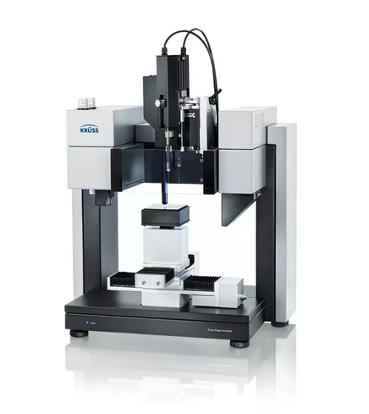
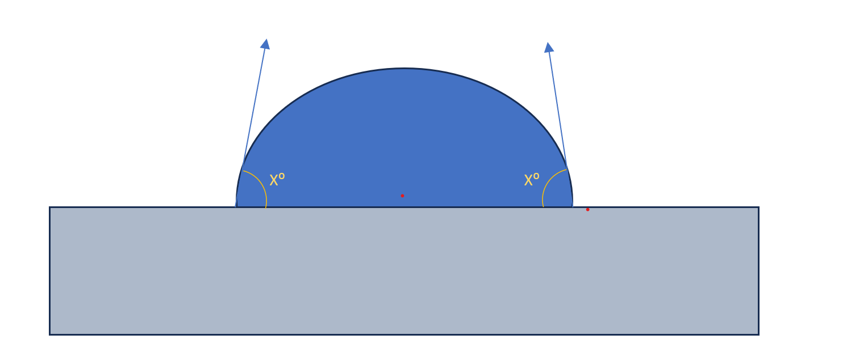
Contact angle measurement
Clean Room Tasks
Used to determine Hydrophobic Properties
Water droplet behavior on the wafer surface determines hydrophobicity
Figure 1 : Contact angle measurement tool
Credits: https://www.kruss-scientific.com
Task:
Record the contact angles for different materials and develop a python script to visualize them.
Analyze the material properties using these measurements
Figure 2 : The image indicates a water droplet on a wafer. X is the angle cast by the droplet circumference with respect to the wafer surface.

Slide 17
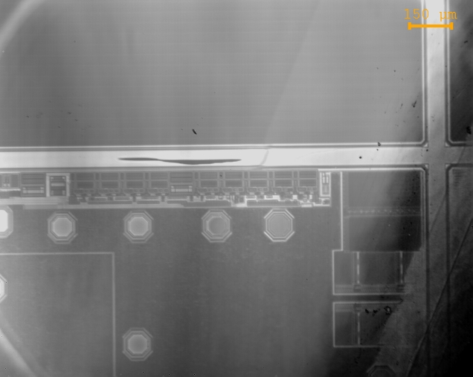
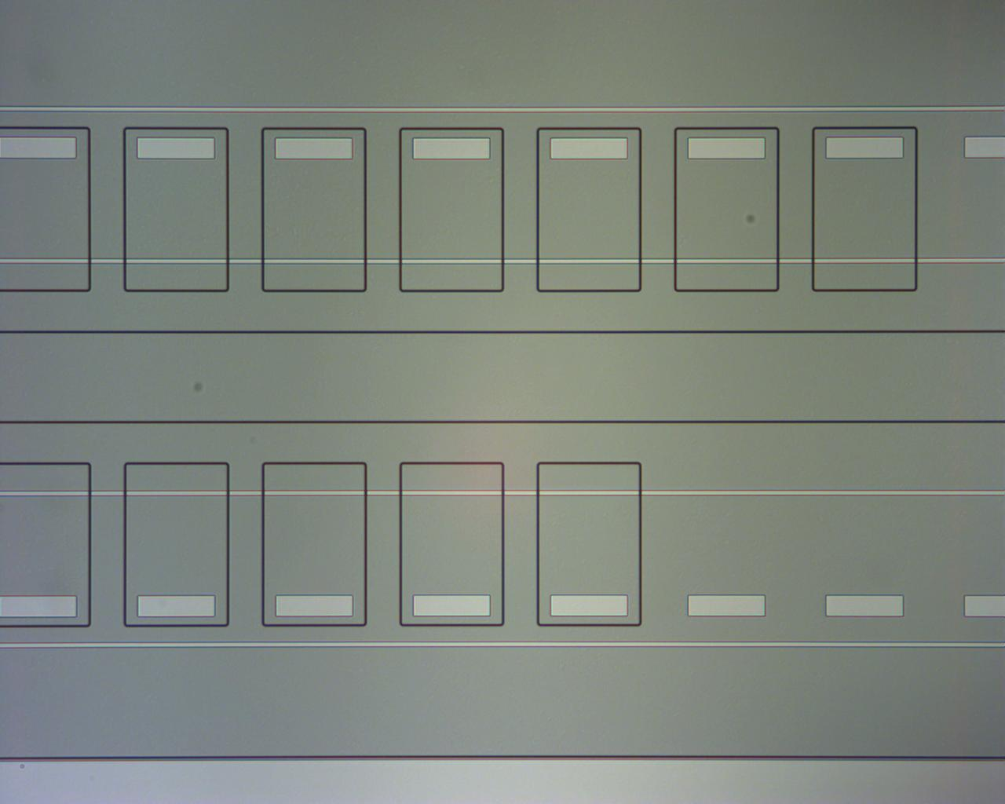
Microscopy
Clean Room Tasks
Microscopy
IR
Optical
Inspection using Infrared (IR) Microscopy and optical microscopy
IR Microscopy principle: IR light passes through the wafer to identify internal structures.
Inspect wafers for irregularities, alignment marks, and lithography steps.
Image captured using IR Microscopy
Image captured using Optical Microscopy

Slide 18
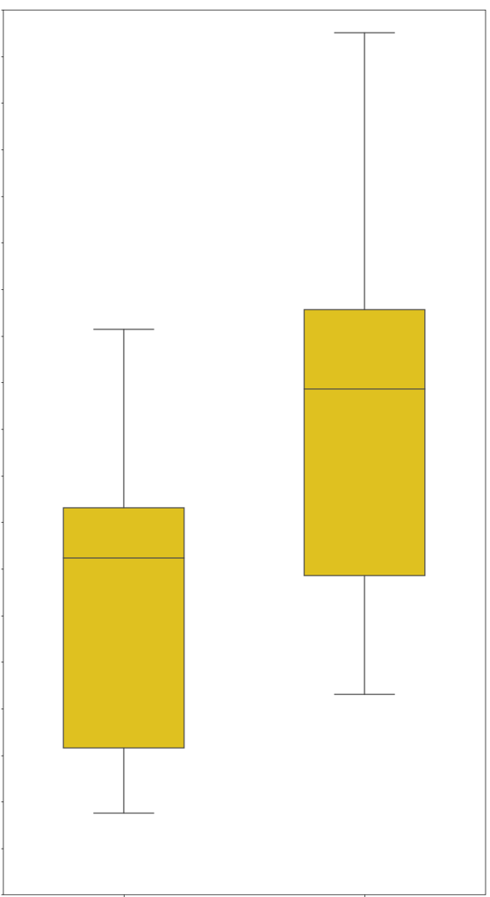
Ellipsometry
Clean Room Tasks
Primarily used to determine the thickness of a material
Helps in the determination of material composition
Task:
Conduct ellipsometry on different wafers and develop a python scrip to visualize the results of the experiment
Analyze the results to determine which process step is suitable for production.
Thickness
X
Y
Image: Example of the results plotting using the python script

Slide 19
04
Git version control and update

Slide 20
Understanding Version Control and Code Optimization
Git version control and update:
Objective:
Gained a fundamental understanding of Git and GitHub, including version control, branching, and collaboration.
Task Description:
Refactored code across all branches of a particular repository.
Converted Jupyter Notebook (.ipynb) files to Python (.py) files.
Cleaned the code: Removed unnecessary metadata, redundant cells, and non-functional parts of the files.
Ensured the Python files are run-ready and compatible with the existing codebase.
Key Tools Learned:
Git & GitHub: Version control, creating branches, committing changes, pushing updates, and resolving merge conflicts.
Beyond Compare: Used for file comparison and merge conflict resolution, ensuring accurate code integration.

Slide 21
05
Conclusion

Slide 22
Conclusion
Conclusion and key takeaways:
Internship Experience: Six-month internship at the Engineering Sensor Technology Center, focusing on sensor manufacturing and development.
Python Script Development: Automated data processes, efficient organization, documentation and visualization using Python libraries.
Quality Management: Implemented quality control and assurance for bonding steps using Python.
Clean Room Tasks: Conducted multiple laboratory tasks, including resist stripping, surface scanning, and IR/Optical microscopy.
Git Version Control: Gained proficiency in Git and GitHub for version control and collaboration.

Slide 23

Key Takeaways
Conclusion and key takeaways:
Practical application of engineering and programming skills
Developed end-to-end automation scripts.
Enhanced data visualization technique.
Enhanced understanding of sensor technology and quality management
Improved quality control processes.
Applied advanced data analysis methods.
Improved proficiency in Python scripting and version control tools.
Gained expertise in libraries such as pandas, NumPy, and matplotlib.
Learned effective version control with Git and GitHub.

Slide 24
Thank you!

